Slide 1
HOUSING: PRICE PREDICTION
By
Manish Kumar

Slide 2
Problem Statement
Houses are one of the necessary need of each and every person around the globe and therefore housing and real estate market is one of the markets which is one of the major contributors in the world’s economy. It is a very large market and there are various companies working in the domain.
A US-based housing company named Surprise Housing has decided to enter the Australian market. The company uses data analytics to purchase houses at a price below their actual values and flip them at a higher price. For the same purpose, the company has collected a data set from the sale of houses in Australia.
The company is looking at prospective properties to buy houses to enter the market. You are required to build a model using Machine Learning in order to predict the actual value of the prospective properties and decide whether to invest in them or not.

Slide 3
Business Goal
You are required to model the price of houses with the available independent variables. This model will then be used by the management to understand how exactly the prices vary with the variables. They can accordingly manipulate the strategy of the firm and concentrate on areas that will yield high returns. Further, the model will be a good way for the management to understand the pricing dynamics of a new market.

Slide 4
About Dataset
Data contains 1460 entries each having 81 variables.
Data contains Null values.
Data contains numerical as well as categorical variable.
Two datasets are being provided to you (test.csv, train.csv).

Slide 5

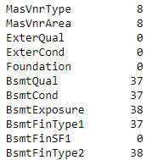
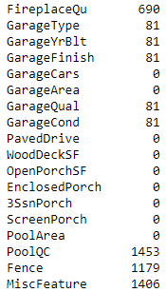
Null Values
There are many missing values present in the dataset. Some of them are due to missing information while others may be due to technical reasoning, for example, in columns like GarageType, BsmtQual, etc, the null values are there because the house does not comprise these features.

Slide 6
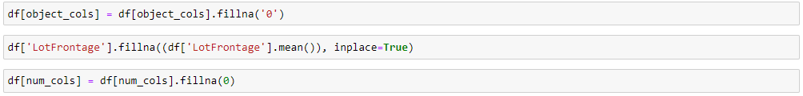
Treating missing values
Some columns like PoolQC, MiscFeature, Alley and Fence has a lot of missing values, hence using synthetic values may not be the best way as it will influence the data vastly. Instead we will just drop these columns.
For other columns we will either replace the missing values with the mean value or 0.

Slide 7
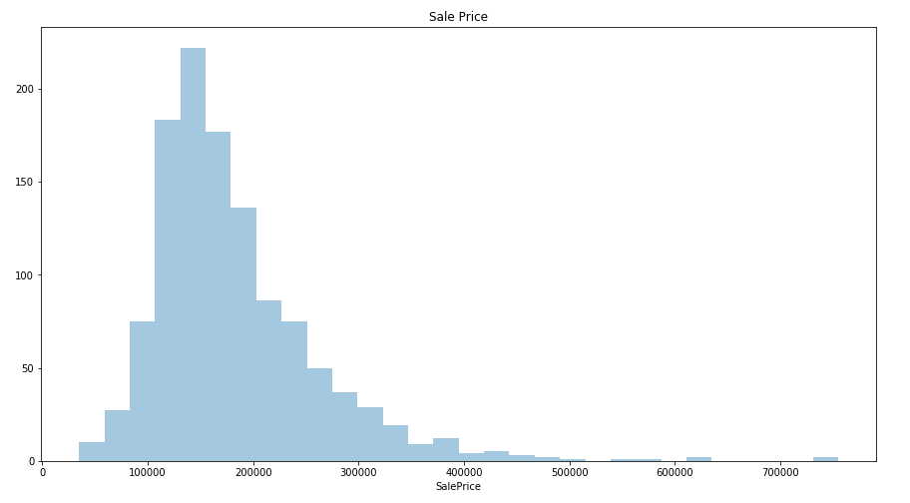
EDA
This is the distplot for the target variable, i.e., SalePrice.
As we can see, the graph is almost perfectly bell shaped.
Sale price has the mean value of 181477.00 and mode value of 163995.00.
The range is 34900.00 - 755000.00 and the IQR is 130375.00 - 215000.00.

Slide 8
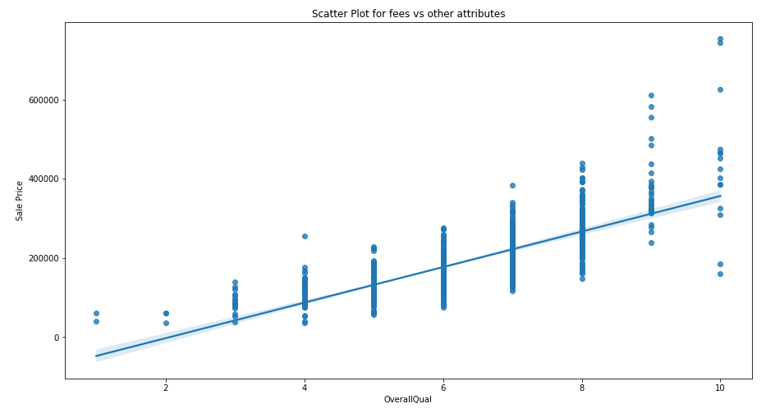
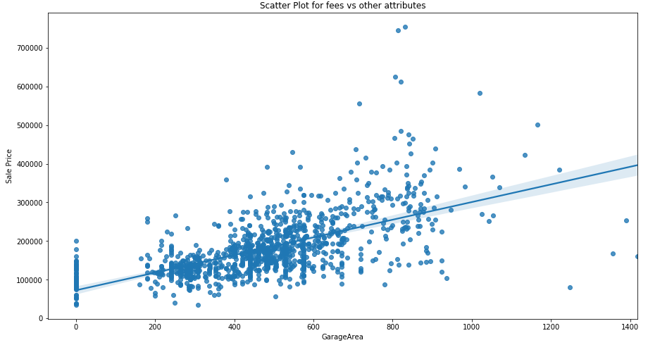
Bivariate Analysis
The following graphs are scatter plots representing the relationship between sale price and various features like overall quality, garage area, etc. As we can see the relationship is linear, with the value of sale price increasing with the quality or area.

Slide 9
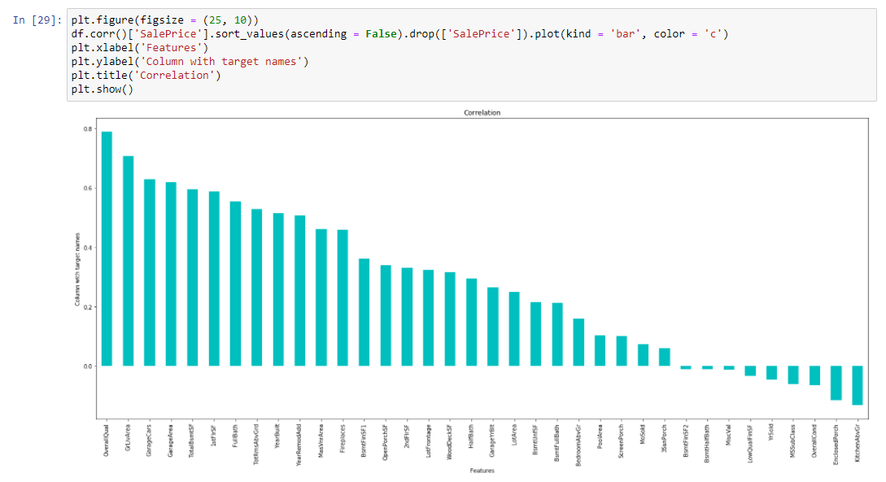
Correlation

Slide 10
Continue...
In the previous slide we can see the correlation between all the continuous variables with the target variable. Using the information acquired from the graph and the heatmap, we decided to drop those columns which have correlation value of less than mod of 0.2.
13 columns were dropped, as seen in the image.
The highest correlation is with overall quality at 0.79.

Slide 11
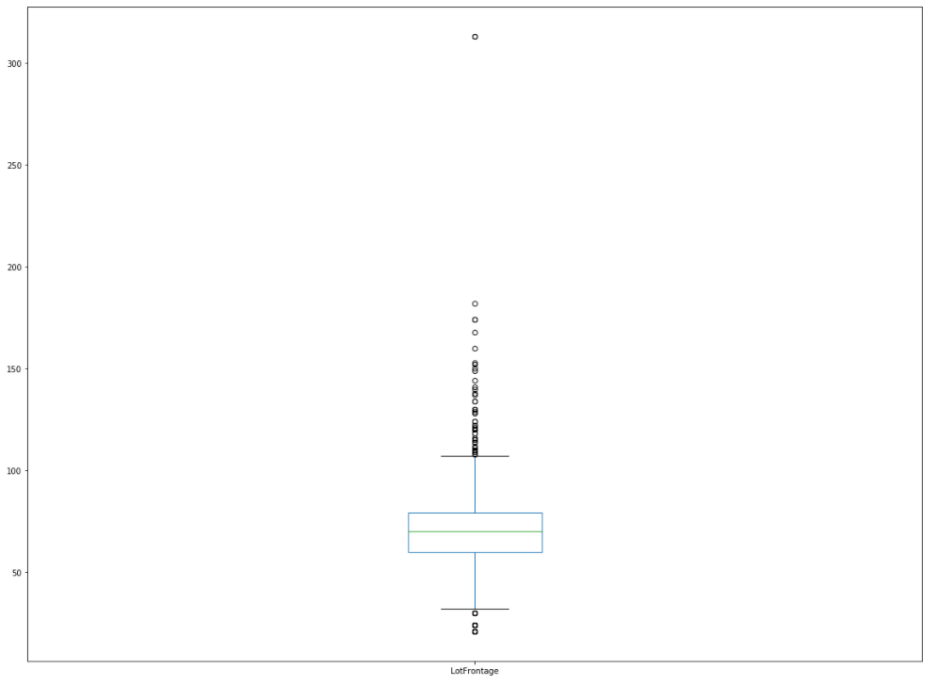
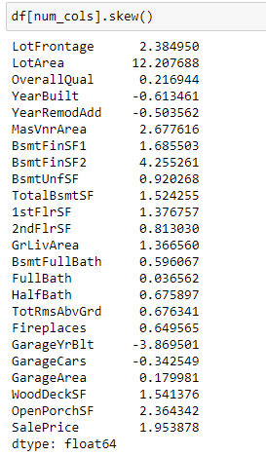
Outliers and Skewness

Slide 12
Continue...
The boxplot in the previous slide is of Lot Area, in the plot we can see there are many outliers present in the data, same is case with somewhat all of the continuous data columns. The other picture is of the skewness present in the dataset. As we can see, almost all of the columns have skewness over the accepted value of +-0.5.
Instead of extensively treating for outliers, we will only treat the skewness present in the data, using power transformer. After treatment the outliers will also drop significantly.

Slide 13
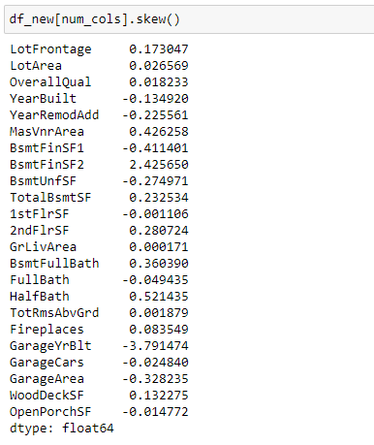
Continue...
As we can see, most of the columns skewness is now within the accepted threshold value of +-0.5.

Slide 14
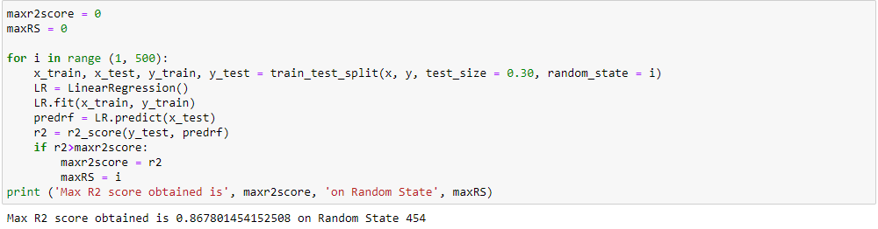
Model Building
The first thing we will do is get the best random state, for train test split. We will do this with the help of a simple linear regression model.
The best R2 score for linear regression we obtained is 0.868.

Slide 15
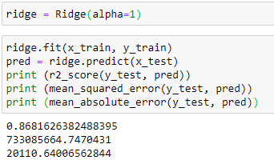
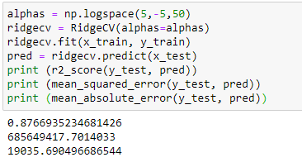
Ridge and RidgeCV
R2 score for L2 regularization for alpha = 1 is 0.868, but after using different alpha values our R2 score also increased to 0.877.
RidgeCV is just ridge regression with inbuilt cross validation, so we don’t have to find the cross validation score extensively.

Slide 16
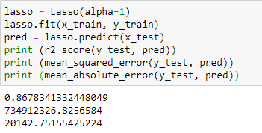
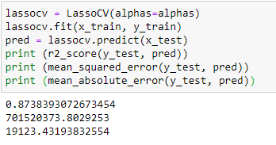
Lasso and LassoCV
We already got improved score after using ridge regression.
Our R2 score L1 regularization for alpha = 1 is 0.868, but after using different alpha values our R2 score also increased to 0.874.
LassoCV is just lasso regression with inbuilt cross validation, so we don’t have to find the cross validation score extensively.

Slide 17
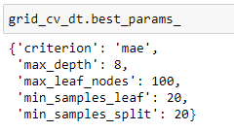
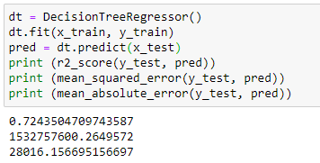
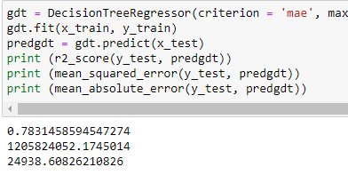
Decision Tree Regressor
R2 score with decision tree regressor dropped to 0.724, but after hypertuning the score improved to 0.783.
The best parameters we got after gridsearchcv can be seen in the image.

Slide 18
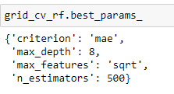
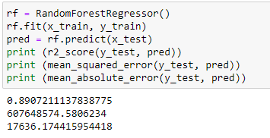
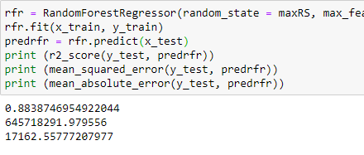
Random Forest Regressor
R2 score with decision tree regressor dropped to 0.891, but after hypertuning the score reduced to 0.884.
The best parameters we got after gridsearchcv can be seen in the image.

Slide 19
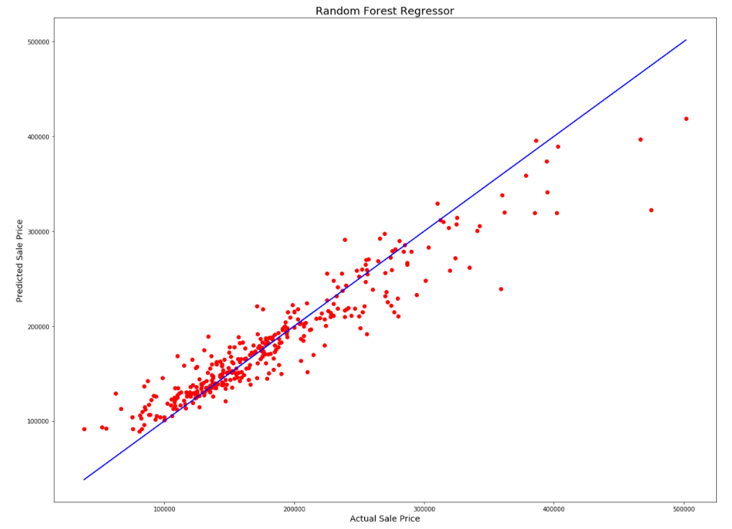
Finalising Model
As we saw after hyper parameter tuning with gridsearchCV our random forest model had the highest accuracy, hence this will be the model that we will finalize.

Slide 20
Conclusion
In this project we learned about housing market and how data science and machine learning can be so helpful in this field.
Using predictive modeling and EDA we can determine which factors impact the market and which factors can be helpful in determining the prices.
After treating outliers, getting rid of redundant columns and other preprocessing, we manage to build a model which will give us fairly accurate results.

